Slide 1

TEAM
JATO
HARISH B - IN0055
SHIBIL S MATHEW - IN0052
ANGELIN PRIYA - IN0061

Slide 2
PROBLEM STATEMENT
JATO Dynamics requires a comprehensive, accurate, and up-to-date dataset of vehicle information from various automotive websites. This data is essential for providing business intelligence and market analysis to the automotive industry. The challenge involves automating the extraction of detailed vehicle data, including make, model, trim, specifications, pricing, and availability, from dynamic and static web pages. The data must be structured and regularly updated to reflect the latest market offerings. The solution must also ensure compliance with legal and ethical standards, particularly in terms of data privacy and website terms of service.

Slide 3
1.Select A Leasing
4.AutoScout
5.Mobile.DE
2.LexAutolease
JATO
WEBSITES
3.Sixt Newwagen Leasing

Slide 4
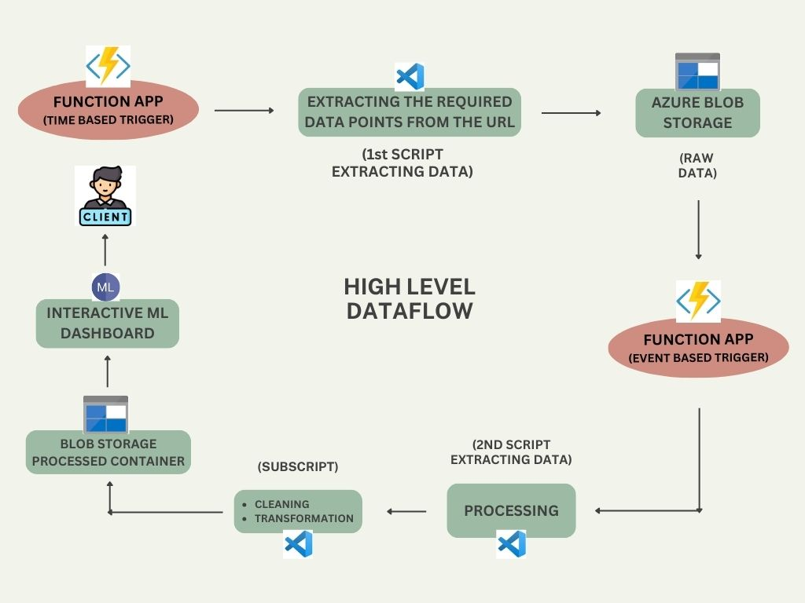

Slide 5
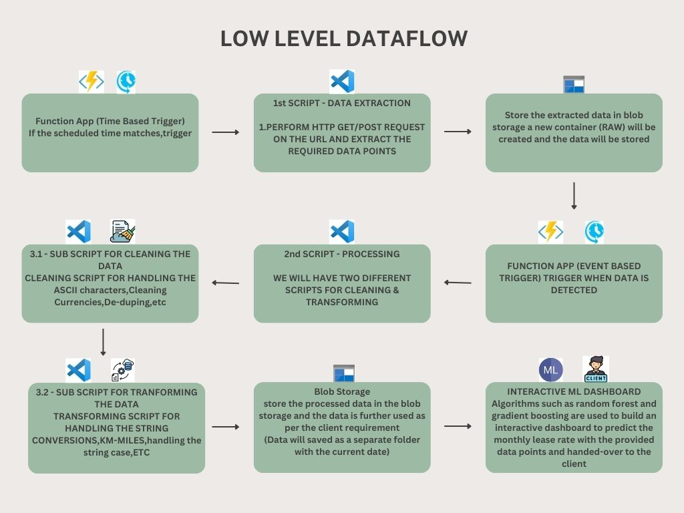

Slide 6
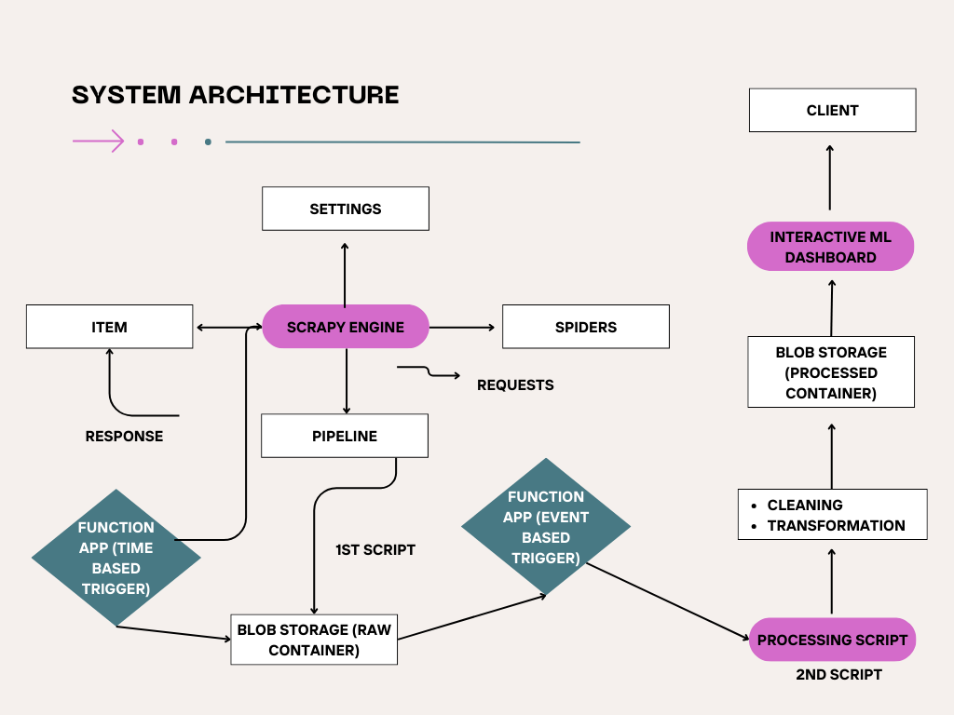

Slide 7
1.Select Leasing
WEBSITE :
https://www.selectalease.co.uk/
PURPOSE :
To extract business lease quotes for vehicles offered by selectlease
OUTPUT :
Extracted data are Stored in the Azure Storage Account
FORMAT :
Used HTML content and the GET method
FIELDS :
Out of 133 fields 54 fields needed to be scraped

Slide 8
2.LexAutolease
WEBSITE
FIELDS
FORMAT
https://www.autoscout24.de/
Out of 133 fields 42 fields need to be scraped
Everything in JSON
01
02
03
04
05
06
PURPOSE
METHOD
OUTPUT
Owners can list their vehicles for sale on its platform with details about the vehicle
POST
The scraped data is stored in Azure Storage Account

Slide 9
3.Sixt Leasing
05
04
03
02
01
OUTPUT
FIELDS
FORMAT
The scraped data were stored in Azure Storage Account
PURPOSE
Out of 133 fields 59 fields need to be scraped
WEBSITE
The content were in HTML format
They provide a wide range of car brands to choose from, allowing customers to configure and compare prices online.
https://www.sixt-neuwagen.de/

Slide 10
4.AutoScout
WEBSITE :
https://www.autoscout24.de/
PURPOSE :
Owners can list their vehicles for sale on its platform with details about the vehicle
OUTPUT :
The scraped data were stored in Azure Storage Account
FORMAT :
The content were in HTML format
FIELDS :
Out of 133 fields 45 fields were need to be scraped

Slide 11
5.Mobile.DE
PURPOSE
FIELDS
To extract leasing offers for vehicles available on mobile.de, which is a popular online vehicle marketplace
Out of 133 fields 37 fields need to be scraped
05
04
OUTPUT
03
01
02
The scraped data were stored in Azure Storage Account
FORMAT
WEBSITE
The contents are in HTML format
https://suchen.mobile.de/

Slide 12
Introduction to Azure Function Apps
Key Features:
Azure Function Apps Overview:
Event-Driven Execution: Azure Functions are designed to be triggered by specific events, whether they are HTTP requests, queue messages, or time-based triggers. This makes them highly versatile in automating various tasks.
Scalability: Function Apps automatically scale out based on the volume of incoming events, ensuring that your application remains responsive even under heavy load.
Cost-Efficiency: You only pay for the time your functions run, making it a cost-effective solution for processing sporadic workloads.
Azure Function Apps are a key component of Microsoft's serverless computing platform, allowing developers to run code in response to various events without the need for infrastructure management. This makes them ideal for scenarios where resources need to be dynamically allocated based on demand, providing a cost-effective and scalable solution.

Slide 13
Trigger Types:
Time-Based Triggers:
Event-Based Triggers:
Functions can be triggered in response to specific events, such as when a new file is uploaded to Azure Blob Storage, a message is added to an Azure Queue, or a web request is received. This allows for highly reactive and efficient processing workflows.
These triggers allow functions to be executed on a scheduled basis, similar to a cron job. This is useful for tasks that need to run at regular intervals, such as daily data backups or periodic API calls.

Slide 14
Final Data Storage
Storage Structure:
The project utilizes Azure Blob Storage to manage different types of data at various stages of the pipeline. Each stage's output is stored in a separate container:
Raw Data Container: Stores the raw or unprocessed data after it is extracted from the URLs.
Processed Data Container: Holds the cleaned and transformed data, which is ready for use in analysis or other downstream processes.
Data Accessibility:
The structured approach to data storage allows for easy access and retrieval of both raw and processed data. Stakeholders can access the processed data directly from the Blob Storage container, ensuring they have the most up-to-date and relevant information available for decision-making.

Slide 15
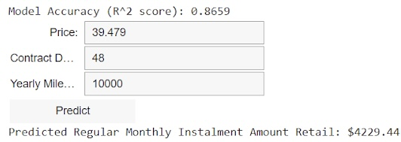
ML INTERACTIVE DASHBOARD
After processing the data, the CSV file is used for Machine Learning analysis and Algorithm such as Random Forest,Gradient Boosting and Linear Regression are used to build an interactive dashboard to predict the monthly lease rate with the provided data points and handed-over to the client

Slide 16
Conclusion
Summary:
Final Thoughts:
The automated data extraction and processing pipeline developed using Azure Function Apps provides a scalable and efficient solution for handling large-scale data from multiple websites. By leveraging both time-based and event-based triggers, the system ensures timely data collection, processing, and storage without manual intervention.
The three-step process — extracting data, cleaning/transformation and Building an ML dashboad — ensures that the data is not only collected efficiently but also processed into a usable format that meets the project’s requirements.
The use of Azure Function Apps for this project highlights the power and flexibility of serverless computing in handling complex workflows. This architecture can be easily adapted to various use cases, making it a valuable tool for data-driven projects.

Slide 17


